Slide 1
LO:
Aim - to be able to:
Identify linear functions
Form linear functions from word problems and related problems algebraically.
PBS Focus: Achieve, attempt all tasks
Plan:
Review rules from graphs
Identify linear equations
Forming linear functions
Need whiteboards and calculators

Slide 2
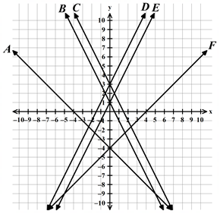
Rules
I do:
Rule for A
Rule for F
We do:
Rule for C
Rule for D
You do:
Rule for E
Rule for B

Slide 3
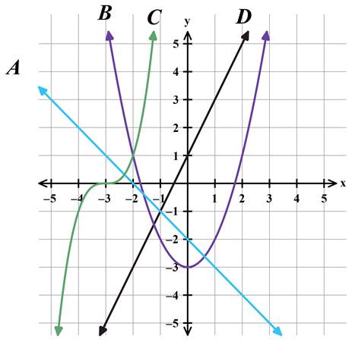
Linear means straight line
Linear functions are those whose graph is a straight line.

Slide 4
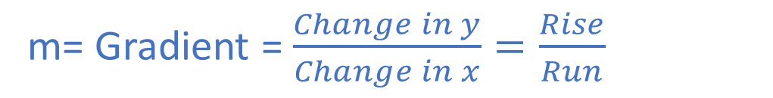
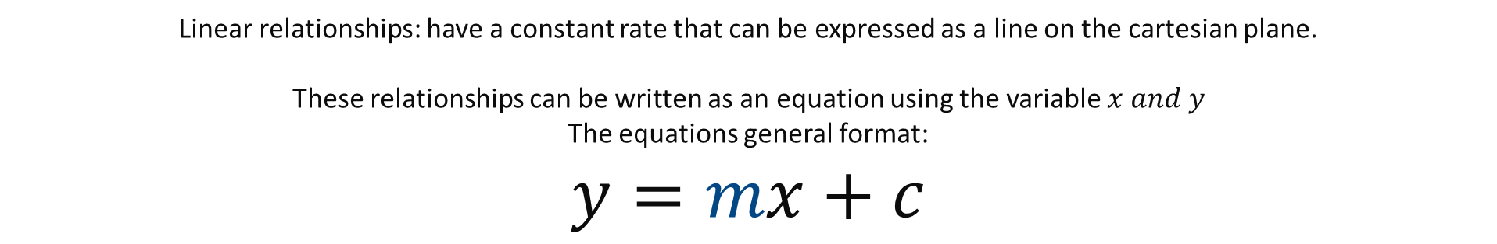
Linear relationships: have a constant rate that can be expressed as a line on the cartesian plane.
These relationships can be written as an equation using the variable $x and y$
The equations general format:
$$y=mx+c$$
m= Gradient = $\frac{Change in y}{Change in x}=\frac{Rise}{Run}$
C= what the y-intercept is (for y)
Which is a Rate
Which is the Starting Value

Slide 5
THINK: what is the rate?
What is the starting value?
Graphing activity

Slide 6
Graphing from a rule
Make the rule (use letters in context)
Make a table of values, starting at zero
Plot these as coordinates
Draw the line (connect the dots)

Slide 7
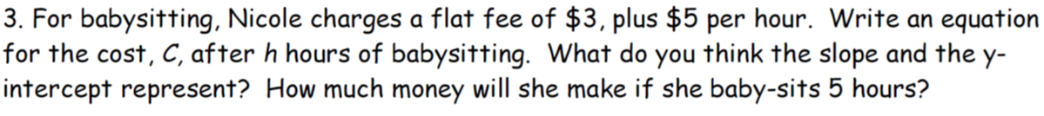
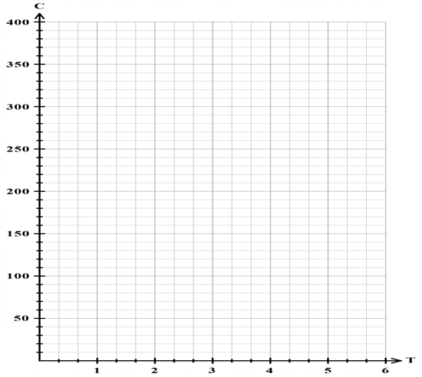
Graphing
Make the rule (use letters in context)
Make a table of values, starting at zero
Plot these as coordinates
Draw the line (connect the dots)
Time in hours (T) | 0 | 1 | 2 | 3
Cost (C)

Slide 8

We do
Make the rule (use letters in context)
Make a table of values, starting at zero
Plot these as coordinates
Draw the line (connect the dots)
Time (H) | 0 | 1 | 2 | 3
Cost (C)

Slide 9

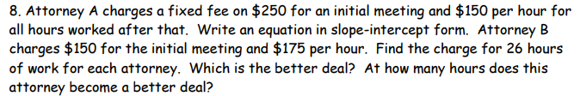
You do
Use a ruler and graph paper to draw your graph and table of values.

